Slide 1
Food and Beverage Management fifth edition
Appendix B
Operational Calculations

Slide 3
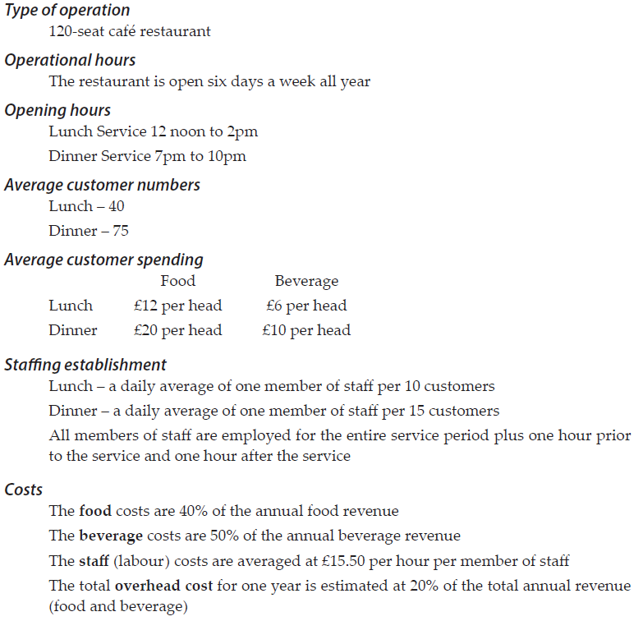
Example
figures

Slide 4
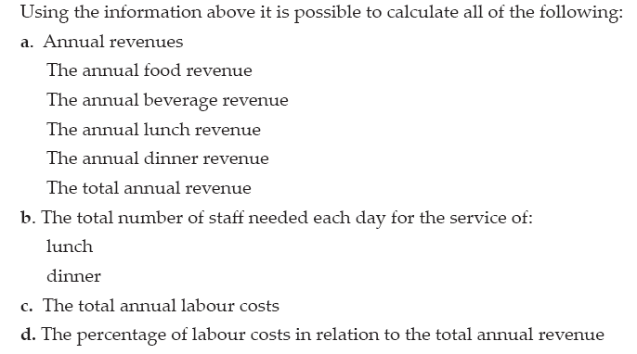
Possible calculations:

Slide 5
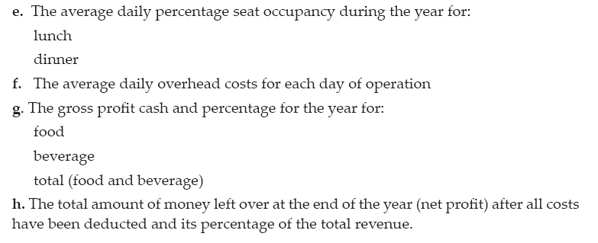
and:

Slide 6
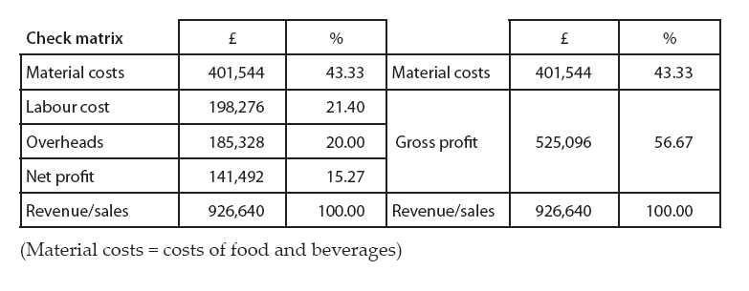
Check matrix
If the calculations are correctly completed then the check matrix should match this one
The details of the calculations are given in Appendix B of Food and Beverage Management 5th edition, Cousins et. al. 2019 Goodfellow Publishers

